Slide 1
Trump?
MAGA?
How?
Why?

Slide 2
The Truth IS… .
Donald Trump was arguably the most egotistical, arrogant bastard to ever sit as president of the US.
There were a few others, like John, Abe, and Teddy, but history has tamed their legacy.
Trump lacked compassion and sympathy.
Although he was overly sensitive to criticism, he was openly critical of others.
He was a self-centered pragmatist.

Slide 3
He was uncontrolled and noncompliant.
He did things his way.
He was often boldly busy doing his work, instead of the work favored by half the nation.
He praised the art of negotiation but did not compromise.
He was terrible to work for and micromanaged almost everything and everybody.
He was unprepared, apolitical, and unconnected.
He had to scrounge for appointees, and still made errors.

Slide 4
He was called almost every castigating word in the book and blamed for things that were not of his doing.
He drew hate and betrayal.
He had few friends, some many enemies, but many many followers.
He reveled in retaliation and denunciation.
He was assertive and pragmatic.
He said and did things that were offensive, disruptive, and obnoxious. (AUTHOR, unknown)

Slide 5
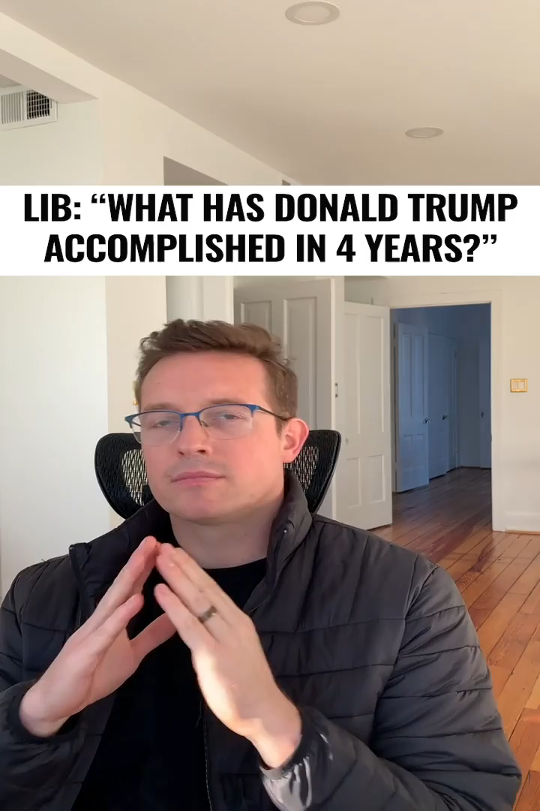
The Bottomline
So, what did he accomplish for
‘We the People’?
Now watch the one-minute video!

